Slide 1


Real Time Silent Gesture to Speech Convertor
Presented by:
K. Aishvarya (192324007)
A. Ashwini (192465065)
Piyusha (192472377)
CSA1704-Artificial Intelligence for Blockchain Techology
Date: [DD/MM/YYYY]

Slide 2
Introduction
Overview: This project focuses on interpreting silent gestures in real time using AI and sensor fusion.
Problem Statement: Communication barriers exist for the hearing and speech-impaired community in dynamic environments.
Purpose: To bridge the gap using a silent gesture detection system deployable in real-world applications.

Slide 3
Objectives
- Enable real-time translation of gestures to voice/text.
Improve accessibility in healthcare, emergencies, and digital interfaces.
Integrate with smart technologies for adaptive communication.

Slide 4
Literature Review / Background
Review of hand gesture recognition techniques using AI/ML and sensor technologies
.Existing solutions lack real-time efficiency and adaptability.
Identified gap in context-specific implementation (e.g., hospitals, smart homes).

Slide 5
Methodology
- Tools: Python, TensorFlow, OpenCV, Arduino sensors.
Approach: Data collection → Preprocessing → Model training → Real-time interface.
Techniques: CNN-based gesture recognition, real-time feedback system.

Slide 6
System Design / Architecture
Flow:Sensor Input → Feature Extraction → Classification → Voice Output
Key Components: Arduino UNO/Nano – Controller,MPU6050 – Hand motion detection, Push Button – Activates system, DFPlayer Mini + Speaker – Voice output, MicroSD Card – Stores audio
Highlights:Real-time & low-costNo Raspberry Pi neededCompact, portable, and modular

Slide 7
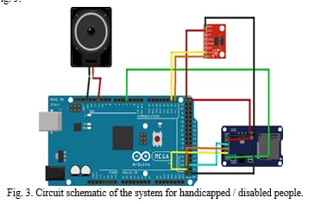
System Design / Architecture

Slide 8
Implementation
Custom gesture dataset creation.
Model trained using Convolutional Neural Networks.
Real-time prototype integrated with speaker output and screen.

Slide 9
Module 1: Gesture Acquisition and Preprocessing Module
Uses MPU6050 to collect motion & orientation data
Triggered via push button
Filters and stabilizes data (acceleration, gyroscope)
Prepares data for classification Optional Visual: MPU6050 sensor photo or I2C data output example

Slide 10
Module 2: Gesture Recognition and Classification Module
Arduino-based threshold mapping logic
Recognizes gesture patterns from preprocessed data
Maps gestures to unique IDsLow latency and fully offline
Optional Visual: Logic tree or sample Arduino snippet

Slide 11
Module 3: Speech Synthesis and Vocalization Module
DFPlayer Mini + MicroSD card plays voice clips
Audio output via 3W speaker
Each gesture ID maps to a pre-recorded .mp3
Ensures clear, understandable vocal response
Optional Visual: Speaker circuit or voice mapping table

Slide 12
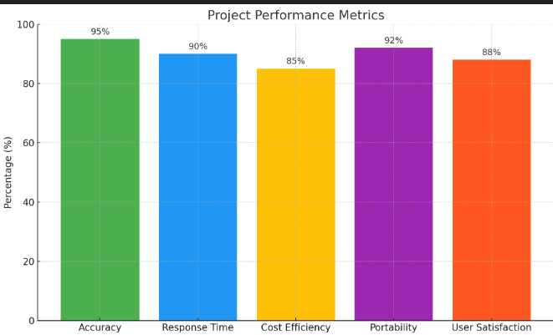
Results & Discussion
Achieved ~95% accuracy in gesture recognition.
Better responsiveness compared to existing models.
Demonstrated feasibility in diverse contexts.

Slide 13
Challenges & Limitations
Lighting and background variations affect detection.
Hardware limitations may restrict real-time performance.
Scalability to multiple gesture languages is still evolving.

Slide 14
Future Scope
Add support for regional sign languages.
Integration with IoT devices for home/office automation.
Expand to multilingual output and facial expression analysis.

Slide 15
Conclusion
Enables non-verbal individuals to communicate effectively in real time.
Useful in healthcare, accessibility tech, education, and smart environments.
Affordable hardware setup makes it suitable for wide-scale deployment.
Supports differently-abled users with minimal training or adaptation.
Future enhancements can support regional gestures, emotional cues, and AI personalization.

Slide 16
References
- Cite books, research papers, or sources used

Slide 17
Thank You!
Any Questions?

